Slide 1

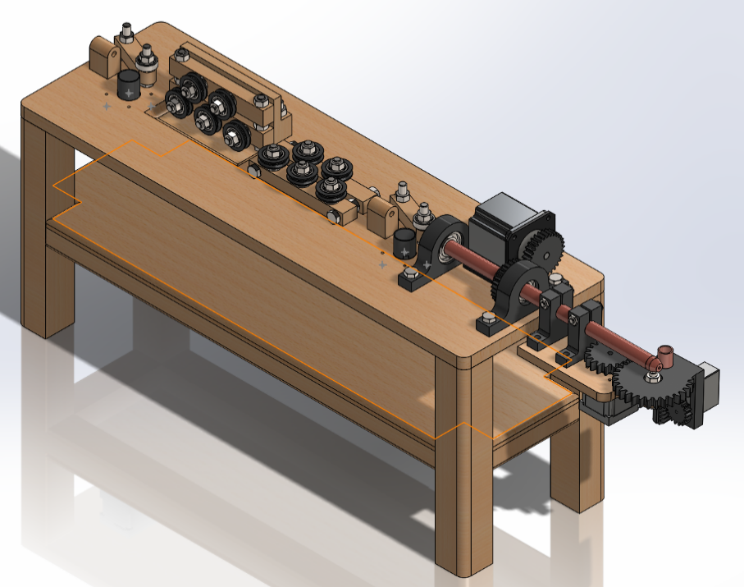
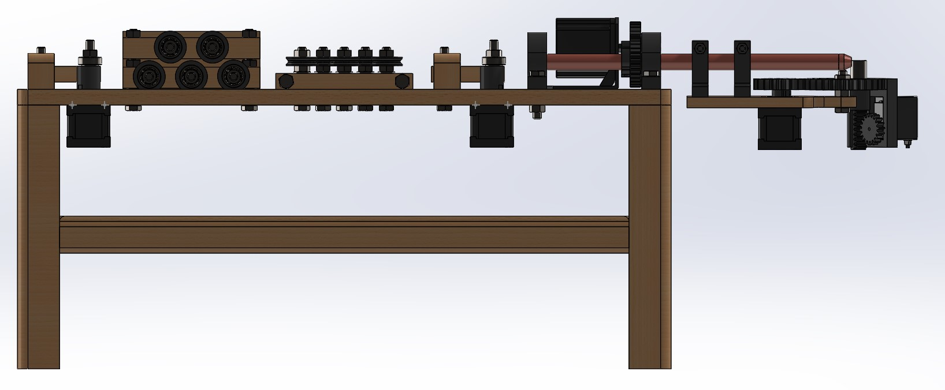
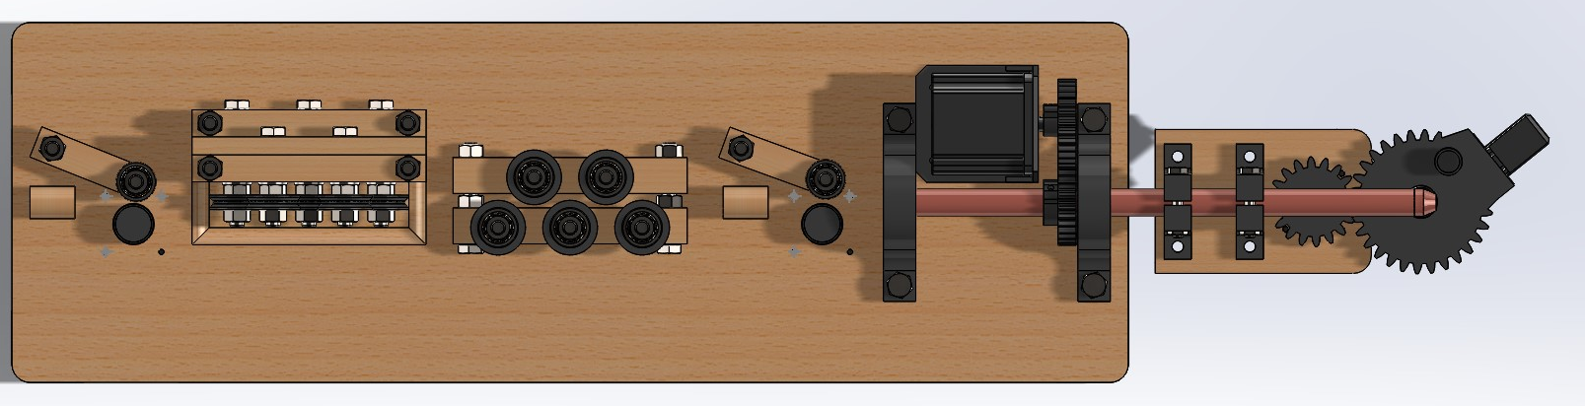
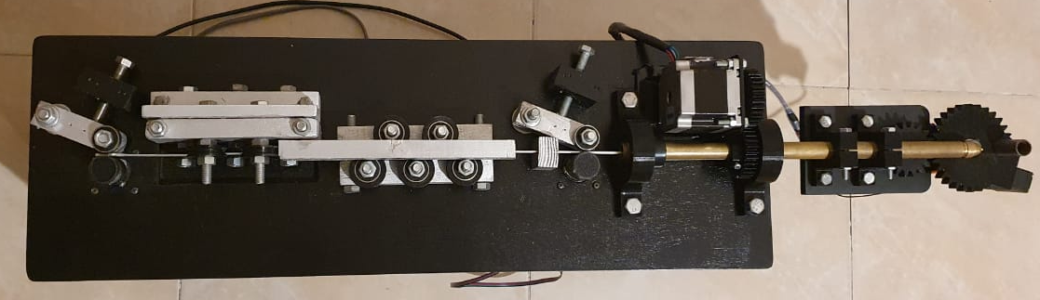
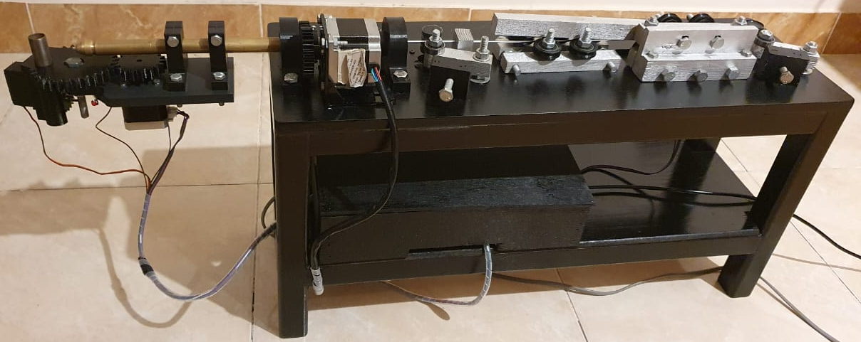
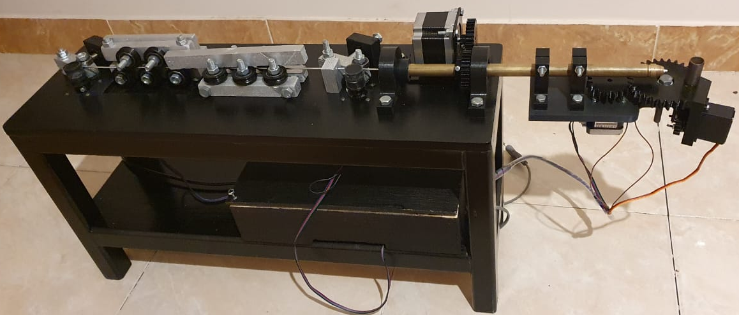
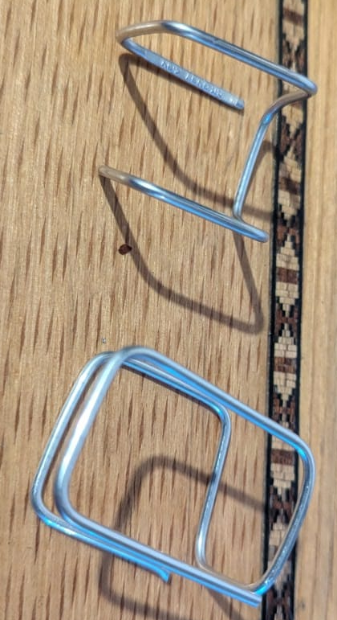
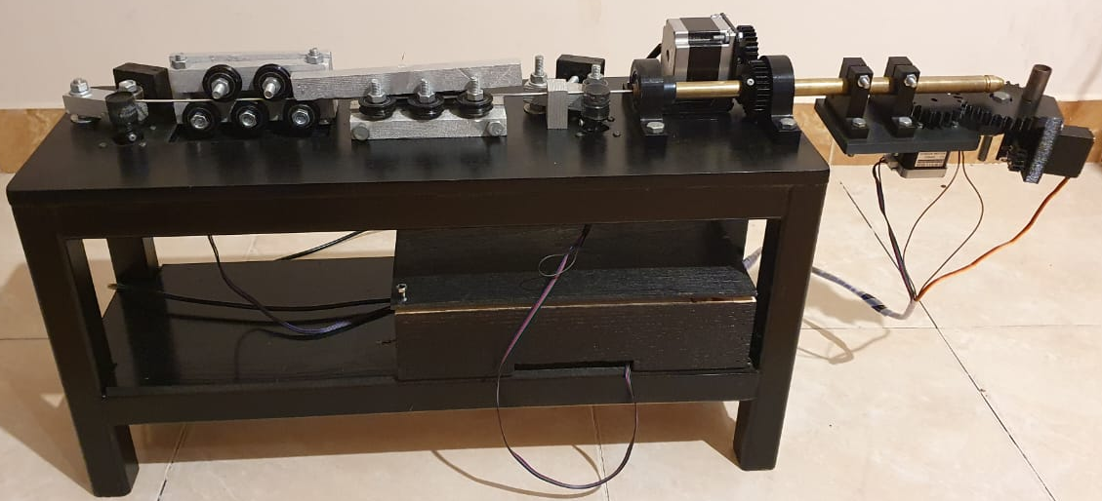
MISR UNIVERSITY FOR SCIENCE AND TECHNOLOGY | 3D Wire Bending Machine |  |  | Department of Mechatronics Engineering College of Engineering Fall 2023-2024
 | Supervisors Dr. Bahaa Nasser Prof. Dr. Mohamed Hamdy Prof. Dr. Mohamed Ibrahim Ass. Prof. Tahani William Dr. Ahmed Sabry | ID | NAME
 |  | 81055 | Hesham Yassin El-Sayed
 |  | 80847 | Kareem Mohamed Anwer
 |  | 81078 | Hazem Mostafa
 |  | 95885 | Hady Ayman
 |  | 77234 | Idris Kabir Masari
summery | PROJECT FIGURES |  |  | COST
PROJECT objectives | RESULTS |  |  | CONCLUSIONS
the 3D wire bending machine that we developed is a versatile and affordable tool that can be used to create a wide variety of wire structures.
The machine is capable of bending wire in all three dimensions, making it ideal for prototyping complex designs.
The machine is also relatively easy to use, requiring only basic programming skills.
9000 EGP for the small model with Stepper Motor (NEMA-17) in the bender and Z-Axis.
9500 EGP for the small model with Stepper Motor (NEMA-17) in the bender and Stepper Motor (NEMA-23) in Z-Axis.
10000 EGP for the Stronger model with Stepper Motor (NEMA-23) in the bender and Z-Axis.
To develop efficient and automated 3D wire bending machine.
To design and develop cost-effective 3D wire bending machine.
To analyses the suitability of the 3D wire bending machine for various applications.
The 3D wire-bending machine has higher integration and production efficiency.
We believe that our 3D wire bending machine has the potential to be a valuable asset to a variety of industries, including manufacturing, engineering, and design.
The machine can be used to create prototypes for new products, fixtures, and mechanisms. It can also be used to repair or modify existing parts.

